Slide 1
An Introduction to Business & Management

Slide 2
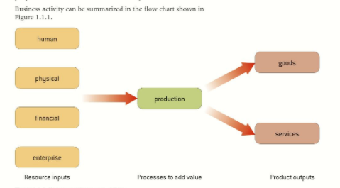
The Role of Business
Producing crops or extracting raw materials from the earth
Creating a product
Providing a service

Slide 3
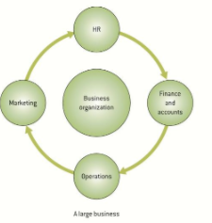
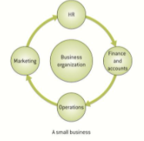
Business Functions

Slide 4
Role of Business Departments
HR-Recruits and trains appropriate hires. Helps to make sure all employee laws are followed
Finance-Ensures funds are available for the operations of the company and records all transactions and financial statements
Marketing-ensures company offers goods and services that are desired by enough customers to make company profitable
Operations-ensures production occurs in a way to make the most cost efficient and quality product/service

Slide 5
Sectors of Business Activity
Goods | Primary | Raw materials – mining, farming, fishing
 | Secondary | Raw material are processed, usually by manufacturing
Services | Tertiary | Services – either by selling manufacturing goods or services
 | Quatemary | Sub group of tertiary that involves e-services, IT, or the media
These sector are typically linked by the “Production Chain” which are the detailed steps to take a raw material and turn it into a consumable good that can be marketed.

Slide 6
Be a Thinker
Think of some everyday products that you use and imagine their production chain. Consider:
a cherry pie from Publix
A skateboard
A cellphone
What primary, secondary, tertiary, and quatemary business are involved in the production, distribution, and marketing of these products?

Slide 7
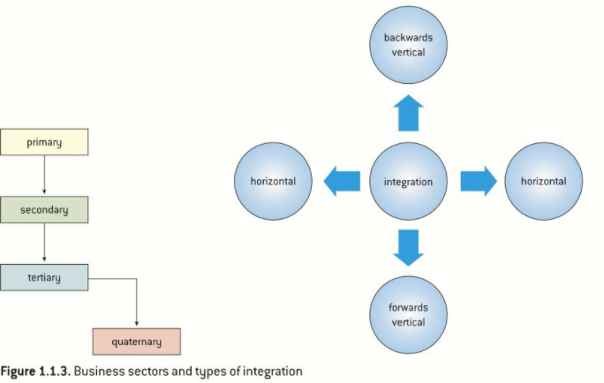
Sectorial Growth and Integration

Slide 8
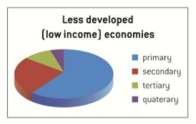
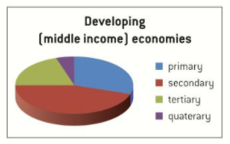
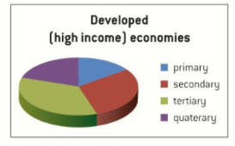
Sectorial Change

Slide 9
Entrepreneurship
Entrepreneur – individual who demonstrates enterprise and initiative in order to make a profit.
Intrapreneur – an individual employed by a large organization who demonstrates entrepreneurial thinking in the development of new products or services.

Slide 10
Reasons for starting up a business
Rewards
Independence
Necessity
Challenge
Interest
Finding a Gap
Sharing an idea

Slide 11
The process of starting up a business

Slide 12
Be a thinker!
Choose one of the following business:
Local delicatessen and café
Manufacturer of a new energy drink
Traveling hairdresser and beautician
After-school sports club
What would be some bullet points for each step of the starting a business process?

Slide 13
The Purpose of a Business Plan
Support
Support the launch of a new organization of business idea
Attract
Attract new funds from banks, grant providers, or venture capitalists
Support
Support strategic planning
Identify
Identify resource needs
Provide
Provide a focus for development
Work
Work as a measure of business success

Slide 14
The Elements of a Business Plan
The business idea, aims, and objectives
Business organization
HR
Finance
Marketing
Operations

Slide 15
Key Questions
How will we create the business idea in the correct context? The Idea!
How will we organize the business? Organization!!
How will we staff the business? HR!!
How will we finance the business? Financing!!
How will we market the business? Marketing!!
How will the product be made? Operations!!

