Slide 1
Unit 1.3
Organization Objectives

Slide 2
Mission/Vision
Vision statement – forward looking with long term aims and high aspirations of the business (What do we want?)
Mission statement – more grounded in the aim of accomplishing objectives to achieve the mission, an immediate step on the way to the vision (Why are we doing what we are doing?)

Slide 3
Objectives (specific and 3 types)
Strategic – long term goals (usually set by senior managers) How to achieve the vision!
Tactical – medium to short term goals (usually set by middle managers) How to achieve the strategic goals!
Operational – day to day objectives (usually set by the floor managers) How to achieve the tactical objectives!

Slide 4
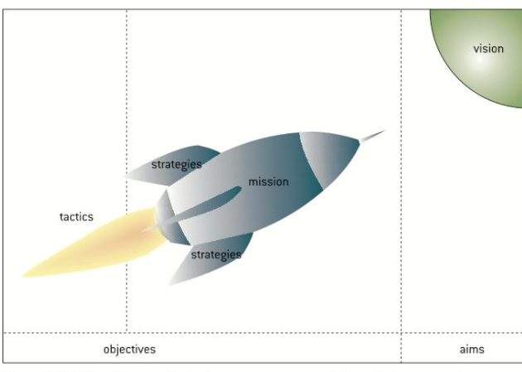

Slide 5
Hierarchy of Objectives
Vision (Aim) – To be the most successful car dealership in the city.
Strategic – To have the highest market share of car dealerships in the city.
Tactical – To hire and retain enough salespeople so that the dealership has sufficient salespeople to serve customers at all times.
Operational – To have the average amount of time that a customer waits to be greeted by a salesperson to be less than two minutes.

Slide 6
SMART Objectives
Specific
Measurable
Achievable
Relevant
Time-specific
A business strategy is a plan to achieve a strategic objective
A business tactic is a plan to achieve a tactical objective

Slide 7
Do objectives change?
Yes, based on internal factors
Yes, based on external factors
Leadership
HR
Organization
Product
Finance
Operations
Social
Technological
Economic
Ethical
Political
Legal
Ecological

Slide 8
Ethical Objectives……..why?
Building customer loyalty
1
Creating a positive image
2
Developing a positive work environment
3
Reducing risk of legal action
4
Satisfying customers expectations
5
Increasing profits
6

Slide 9
Corporate Social Responsibility
The concept that a company has an obligation to operate in a way that will have a positive impact on society!
Ethical objectives could be born out of a CSR!
A company committed to a CSR is intending to act as a good “corporate citizen”!
By recognizing its CSR, a business is ore than likely to have a “sustainable business model”
Since around 1980 the movement towards CSR has been significant and led to dramatic changes in the attitudes and practices of businesses.

Slide 10
SWOT Analysis
Helps to set the businesses SMART objectives of the strategic plan
The SWOT matrix is based on perceptions. The wider the sources and the more reliable the data, the stronger will be the analysis of the SWOT factors.
 | Positive Factors | Negative Factors
Internal to the business | Strengths | Weaknesses
External to the business | Opportunities | Threats

Slide 11
SWOT Analysis & Market Position
 | Strengths | Weaknesses
Opportunities | S-O Growth strategies | W-O Re-orientation strategies
Threats | S-T Defusing strategies | W-T Defensive strategies
Using the SWOT matrix and pairing key factors from each quadrant can help to develop a relevant strategy!!

Slide 12
The Ansoff Matrix
Product
 | Existing | New
Existing | Marketing penetration | Product development
New | Market development | Diversification
M
a
r
k
e
t

