Slide 1
Unit 1.4 Stakeholders

Slide 2
Key Terms
Stakeholder – an individual or group who has an interest, often financial, in activities and success of an organization
Shareholder – an individual who owns a share or shares in a company
Competitor – another business or organization offering very similar goods or serices

Slide 3
Internal Stakeholders
Shareholders
CEO, directors
Senior managers
Middle managers
Foremen and supervisors
Employees and unions

Slide 4
External Stakeholders
Government
Suppliers (Vendors)
Customers and consumers
Local community
Financiers
Pressure groups
Media

Slide 5
Conflicts between stakeholders????
CEO and senior managers would in principle probably support paying higher wages, as this would make the employees happier. However, with responsibility for meeting profit targets and return on investment ratios, would also worried that pay raises would lower profits.
Managers may be concerned that, by reinforcing the use of extrinsic motivating factors, a pay raise might undermine their efforts to foster a culture of intrinsic motivation.
Those in the community would favor a general pay raise as this would mean employees would have more disposable income. However, if the pay raise in any way threatened the existence of the business, they probably would not be in favor

Slide 6
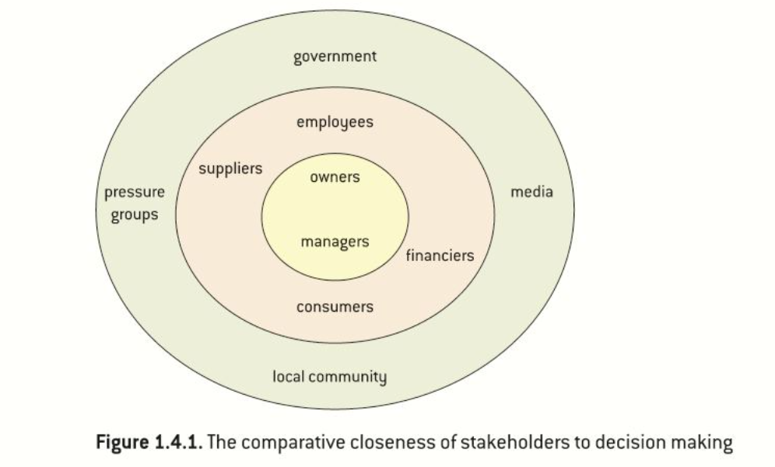
Stakeholder Analysis

Slide 7
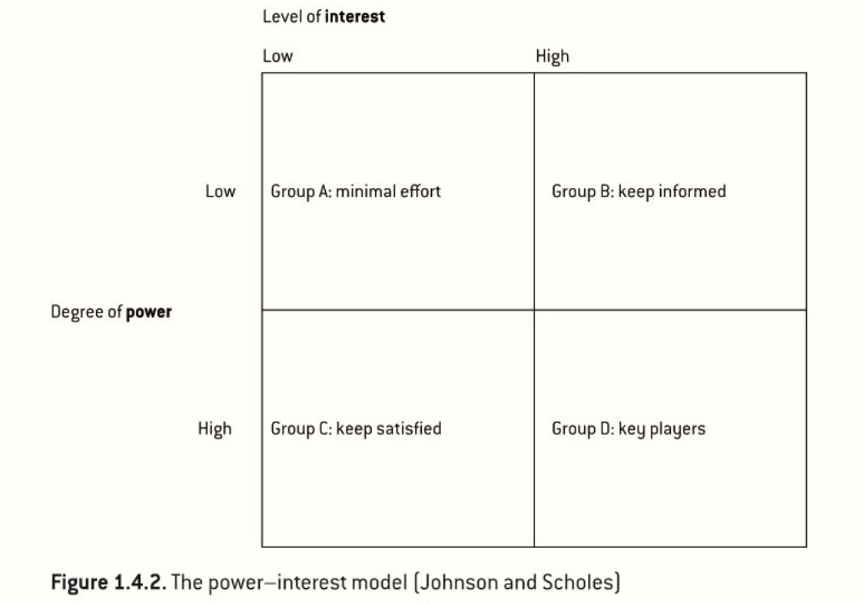
Stakeholder Mapping

