Slide 1
Unit 4.2
Market Planning & the Four P’s

Slide 2
Elements of a Marketing Plan
Marketing Objectives (SMART)
Key strategic plans (Overview)
Detailed marketing actions (Specific activities to be carried out)
The Marketing Budget (finances required to carry out the plan.

Slide 3
Benefits of the Marketing Plan
To identify potential problems
SMART objectives improves chances of success
Sharing the plan with other departments improves coordination
The budget ensures money not wasted
Clear plan improves employee motivation & provides confidence regarding the plan

Slide 4
Limitations to the Marketng Plan
May become outdated due to changes in the market condition
May consume considerable resources
Failure to prioritize objectives could make it difficult for management to see if meeting the objectives

Slide 5
The Four P’s
Product – the goods or services that are provided
Price – the amount consumers will be charged
Promotion – the various ways consumers are informed and persuaded to purchase the product
Place – The products location of channel of distribution

Slide 6
The Marketing Mix
The customers needs and wants are adequately met!
Requires the business to produce the right product, charged at the right price, available at the right place, and communicated through the right promotional channels.

Slide 7
Market Segmentation
Demographic – age, gender, religion, family characteristics, ethnic grouping
Geographic – regions, climate
Psychographic – social and economic status, values

Slide 8
Targeting
Target market is a group of consumers with a common want or need that a company decides to sell to
Mass(undifferentiated) marketing – targets entire market rather than specific segments
Segment (differentiated) marketing – targets one or several market segments to gain a better hold on the market
Niche marketing – Product or service appeals to a smaller more specific market segment
Consumer Profiles – info gathered on regarding characteristics of consumers in a certain market

Slide 9
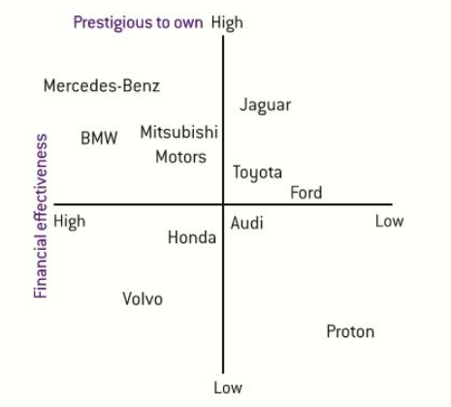
Positioning
How consumers perceive a product vs other products in the market
Position Map – visual representation of how consumers perceive a product vs other products in the market

Slide 10
Unique Selling Point (USP)
A feature that differentiates a product from the competitors
It helps to establish a firms competitive advantage
Leads to customer loyalty

